Slide 1
The Great Fire of London
Key Stage 1 Programme of Fire Safety

Slide 2
Recap
what do you know so far?
where did the fire start?
how did it start?
when did it start?

Slide 3
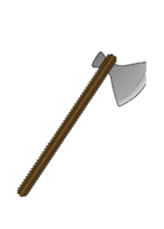
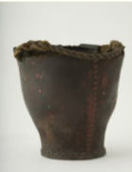
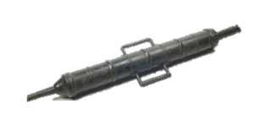
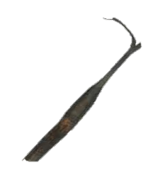
Firefighting in 1666
Talk about what each of these were used for:
Let’s try tackling a fire like they did in 1666!

Slide 4
Firefighting through the ages
17th century

Slide 5
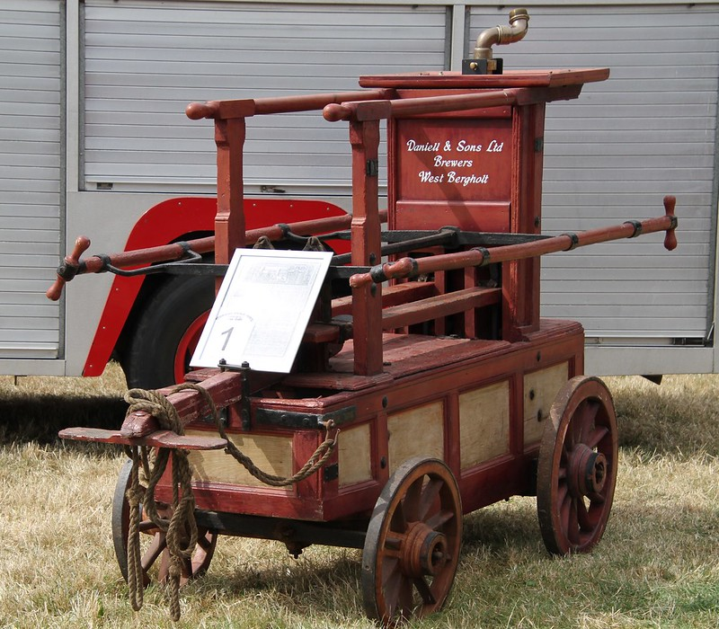
Firefighting through the ages
1770

Slide 6
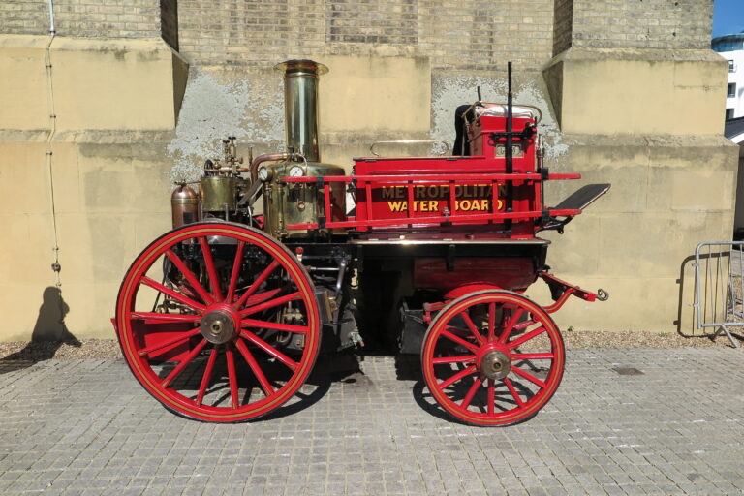
Firefighting through the ages
1880

Slide 7
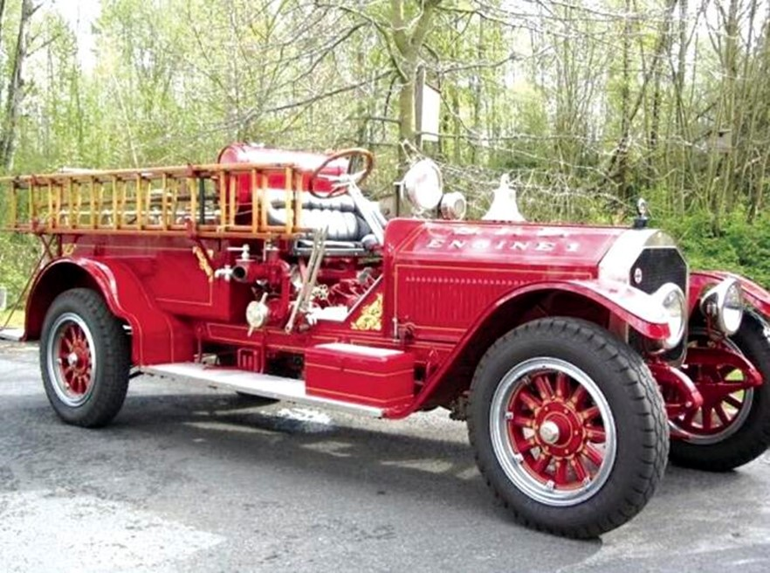
Firefighting through the ages
1919

Slide 8
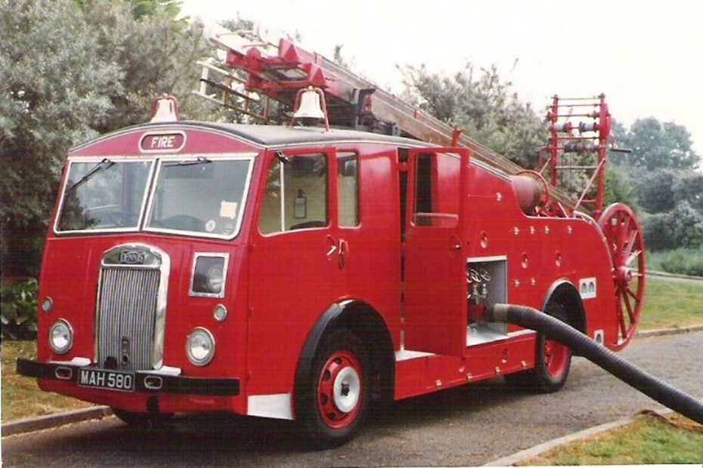
Firefighting through the ages
1951

Slide 9
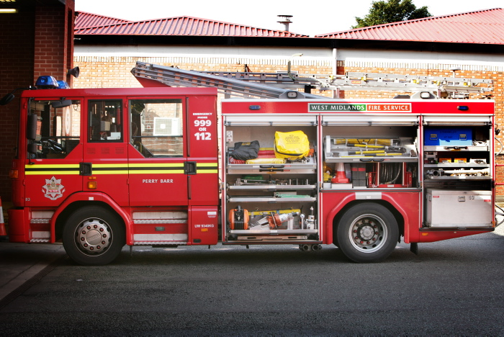
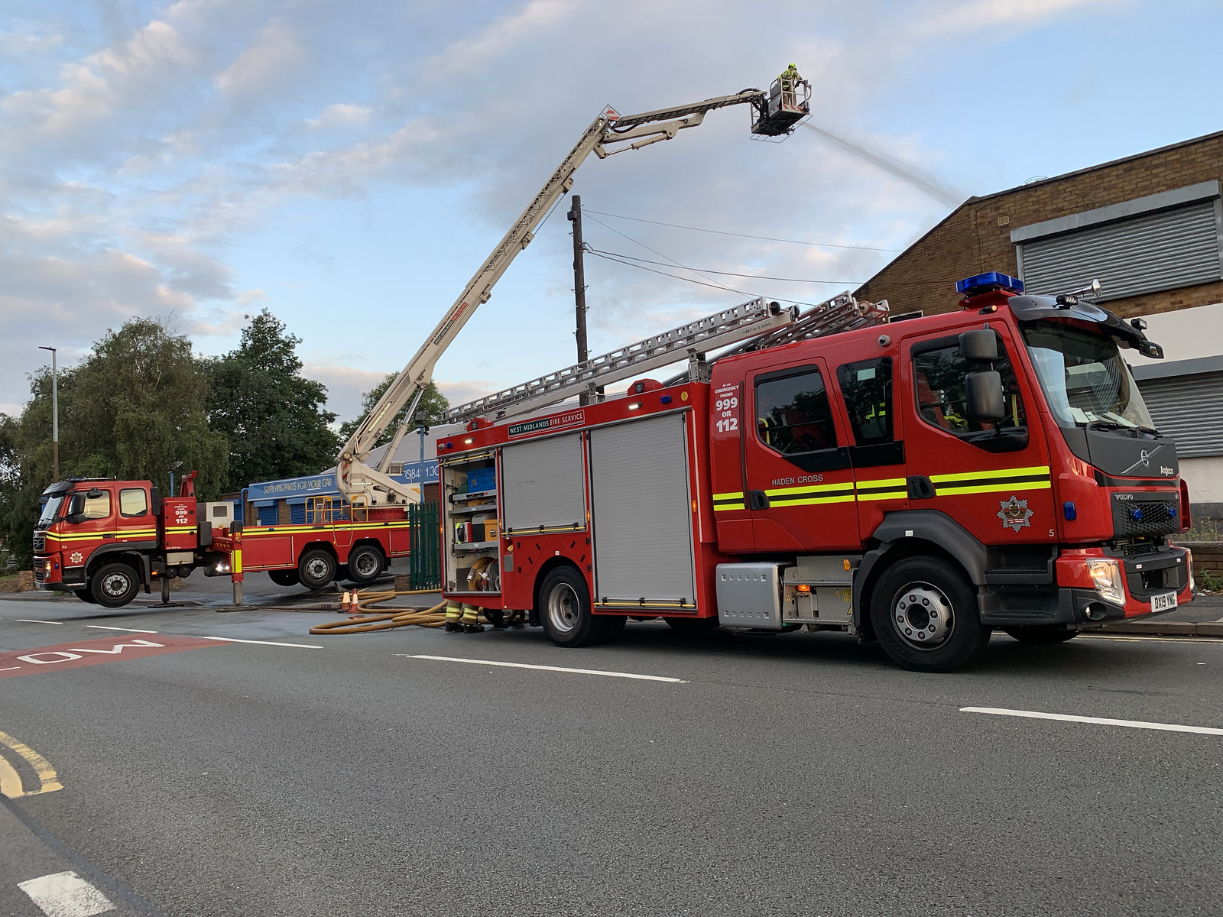
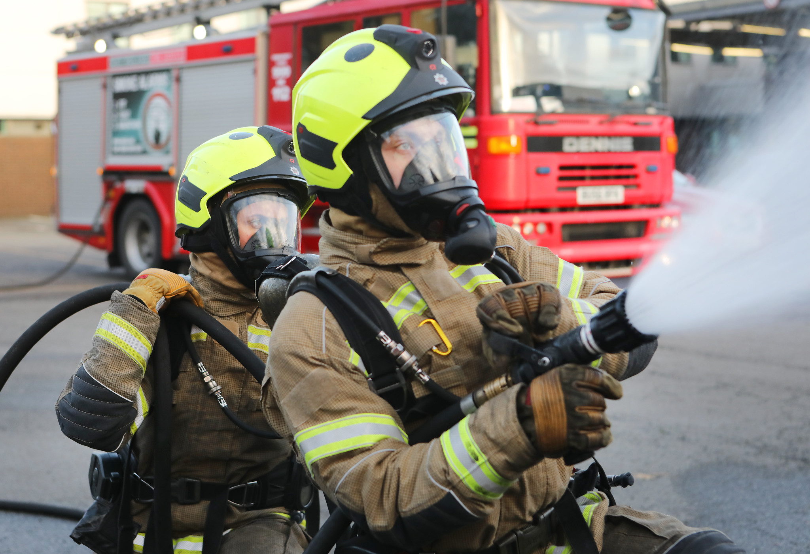
Firefighting now
Talk about what each of these things are used for:

Slide 10
Hazard spotting
what hazards can you find in one of these rooms?
https://staywise.co.uk/public/resource/hazard-house-game

Slide 11
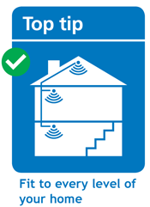
Smoke alarms

Slide 12
Get out, stay out

Slide 13
Stop, Drop and Roll
if your clothes catch fire, what do you do?
let’s practice!
STOP.
DROP.
ROLL.

Slide 14
Other useful websites
www.staywise.co.uk
www.wmfs.net
there is a link to a video you can use with tablets

Slide 15
London in 1666

Slide 16
Teachers – Please complete the form, accessible via the link or QR code below
https://wmfs.link/3vq07NV
Making the West Midlands safer, stronger and healthier

