Slide 1
The Great Fire of London
Key Stage 1 Programme of Fire Safety

Slide 2
Recap
what do you know so far?
where did the fire start?
how did it start?
when did it start?

Slide 3
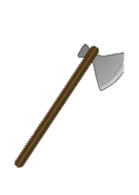
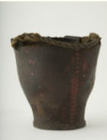
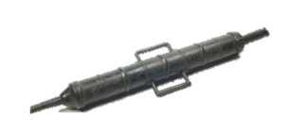
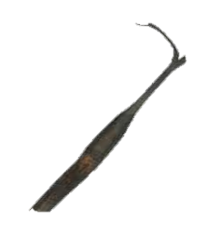
Firefighting in 1666
Talk about what each of these were used for:
Let’s try tackling a fire like they did in 1666!

Slide 4
Firefighting through the ages
17th century

Slide 5
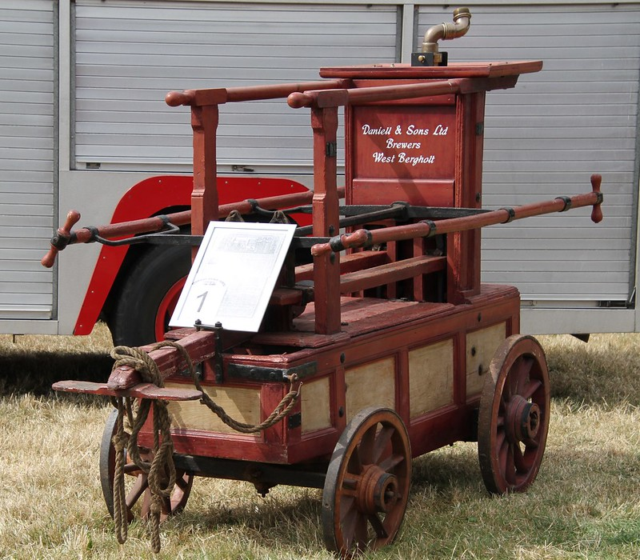
Firefighting through the ages
1770

Slide 6
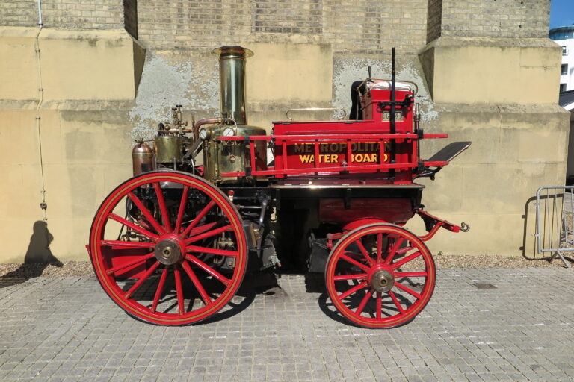
Firefighting through the ages
1880

Slide 7
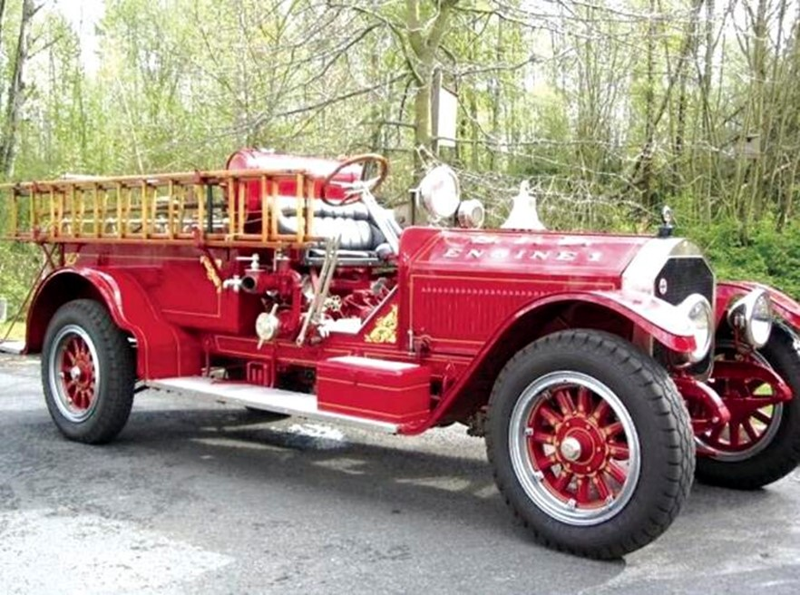
Firefighting through the ages
1919

Slide 8
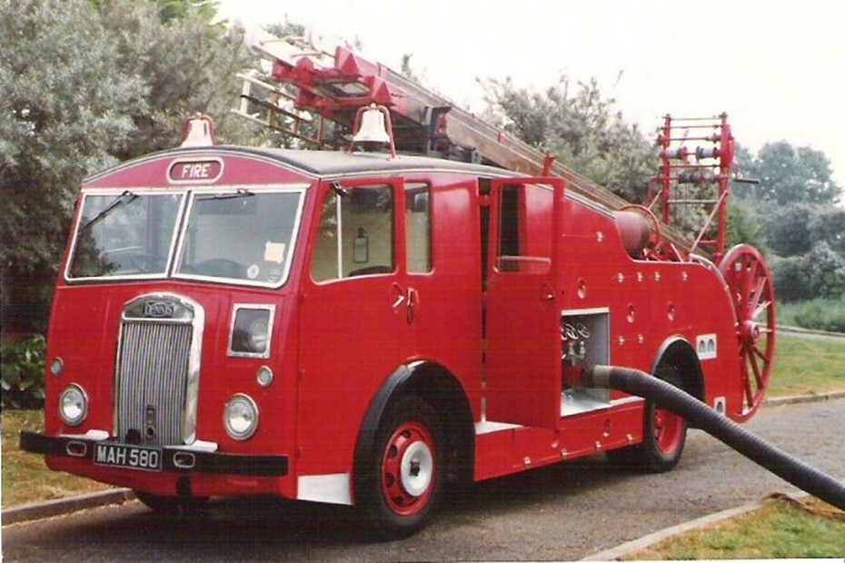
Firefighting through the ages
1951

Slide 9
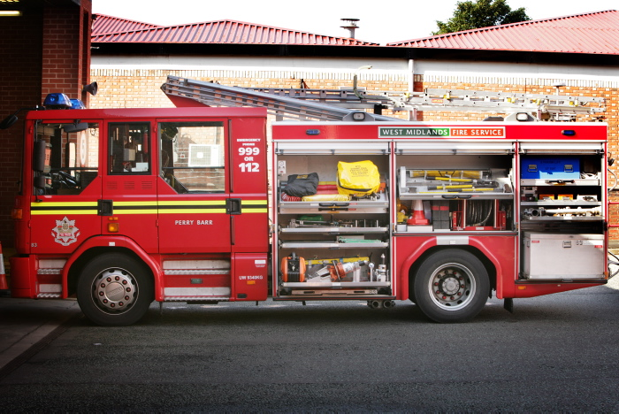
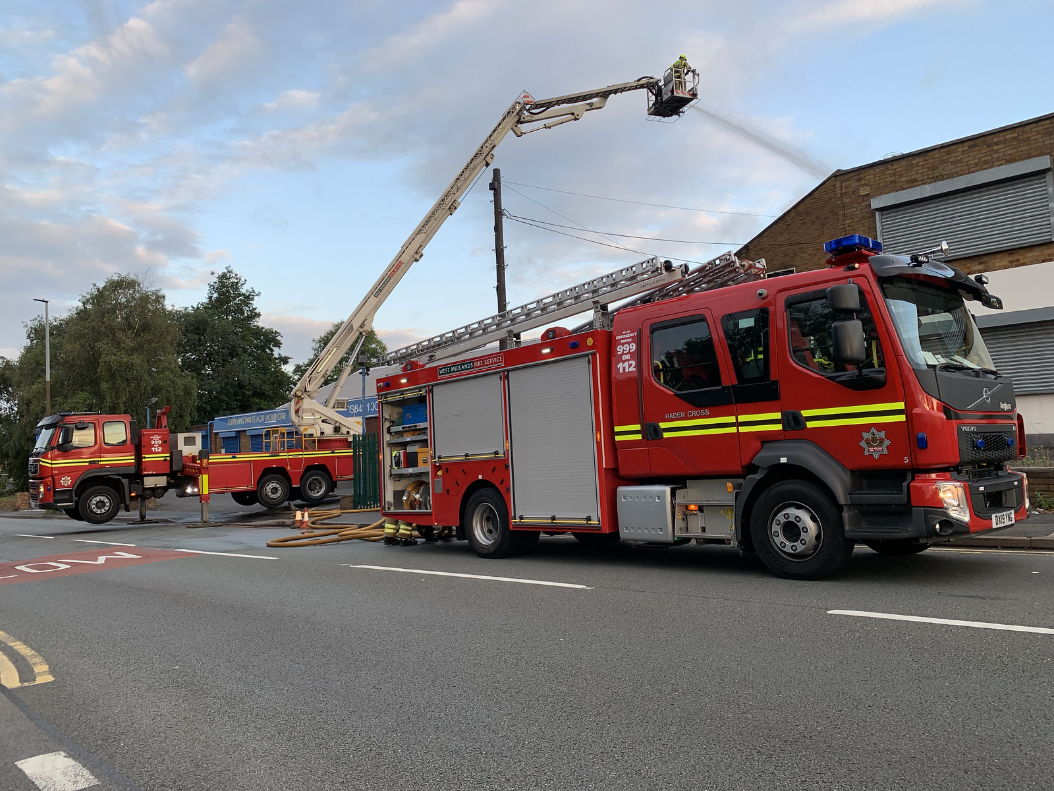
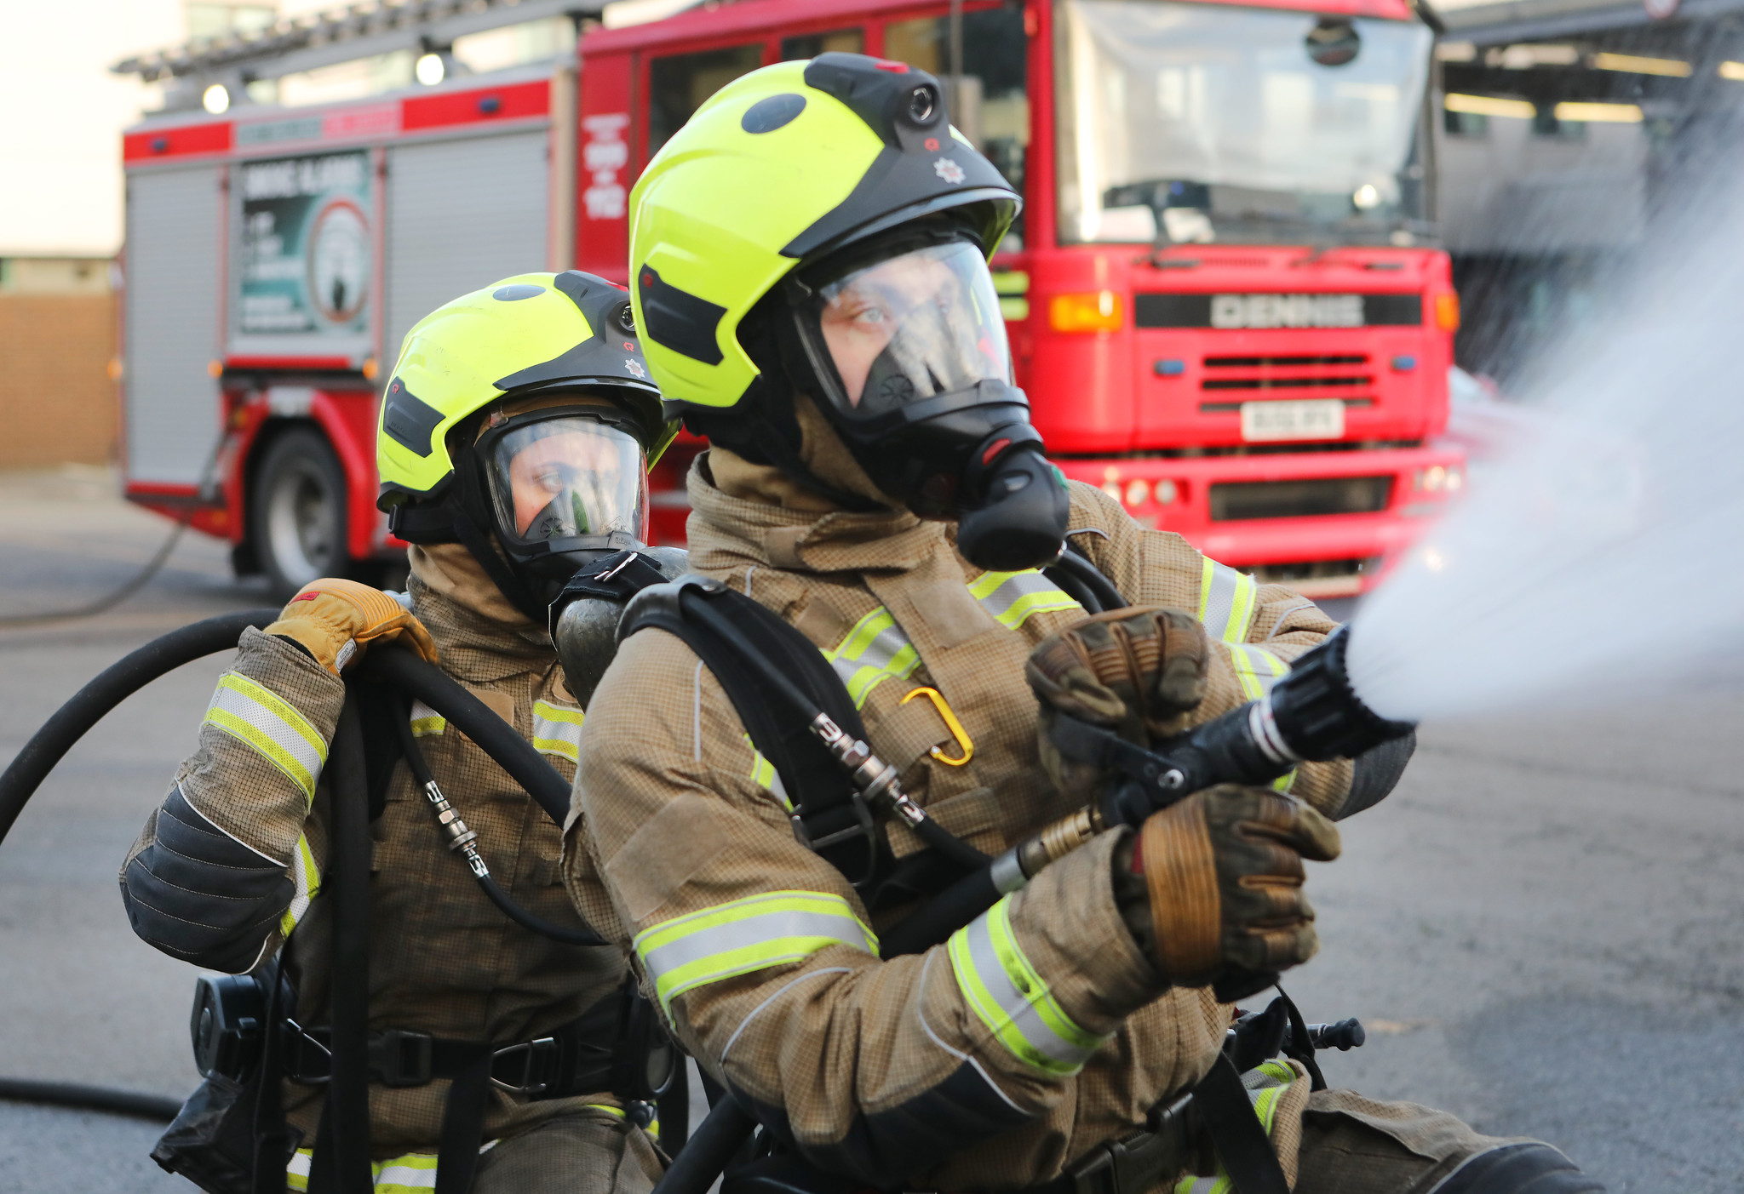
Firefighting now
Talk about what each of these things are used for:

Slide 10
Hazard spotting
what hazards can you find in one of these rooms?
https://staywise.co.uk/public/resource/hazard-house-game

Slide 11
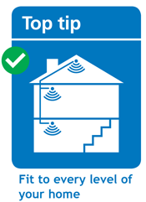
Smoke alarms

Slide 12
Other useful websites
www.staywise.co.uk
www.wmfs.net
there is a link to a video you can use with tablets

Slide 13
Teachers – Please complete the form, accessible via the link or QR code below
https://wmfs.link/3vq07NV
Making the West Midlands safer, stronger and healthier

